Slide 1

Overview
This Software System lets Admin to upload Stock Price of a Company(which is listed in a Stock Exchange) at different points of time. It need to support multiple Stock Exchanges.
And the registered Users should be able to generate various charts to perform Stock Market performance of various Companies or Sectors over certain period of time.

Slide 2
1.Signup/Login/Logout
System
5.View IPOs
1.Signup/Login/Logout
8.Can display in a chart
2.Update profile & password
Solid line: Required task
Dotted line: Optional task
2.Manage Stock Exchanges
13.Multiple comparisons btw cmp/sct
3.Search for a company
Admin
14.Non-existing data indicated
4.Appropriate intervals in charts
User
3.Manage Company
15.Futurn trend
6.Display matching companies
4.Import Excel Data
a company in different periods
7.Comparisons charts
5.Missing Data
a sector in different peiriods
9.different colors companies/sectors
Different sectors in same peiriods
10.Use Bar charts to display data
11.Export data & download in Excel
Different sectors/company in same peiriods
2 company in same periods
12. math properties in the chart

Slide 3
Function Modules
Modules | Case
Login/logout | Admin & Users
Sign up | Admin & Users
Import excels | Admin import company information in excel format
Create and update information | Admin maintain the company information
Generate a chart to show difference | Users want to show the chart to display the difference in stock

Slide 4
Administer View

Slide 5
Login/Signup for Admin
Welcome to Stock Market
User name:
Password:
No account yet? Go to Sign Up!

Slide 6
Login/Signup for Admin
Sign Up
User name:
Password:
Confirmed

Slide 7
Login/Signup for Admin
Sign Up
You have created a new account successfully!
User name:
OK!
Password:
Confirmed

Slide 8
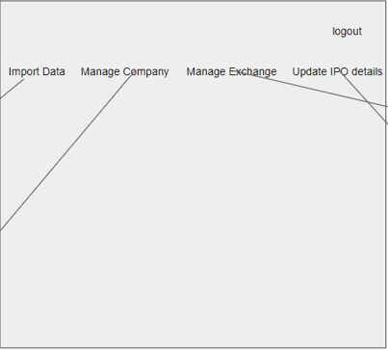
Admin Landing page
All tabs have the same size. Click each tab, information about it will be displayed and the tab size will be bold.

Slide 9
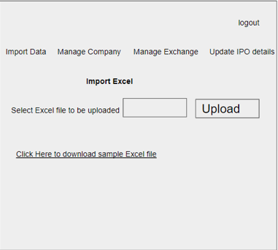
Import data of companies – page 1

Slide 10
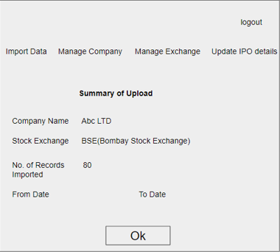
Import data of companies – page 2
Data from the imported file

Slide 11
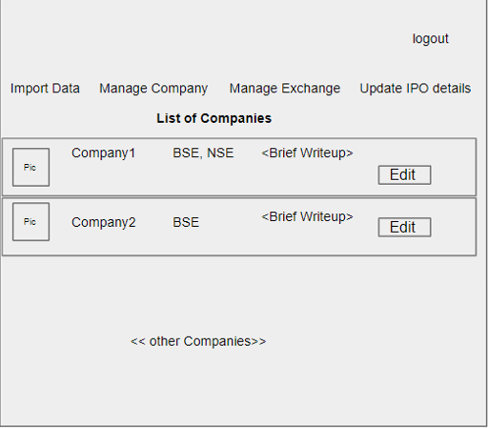
Manage company
Click it and go to next page
Create New Company

Slide 12
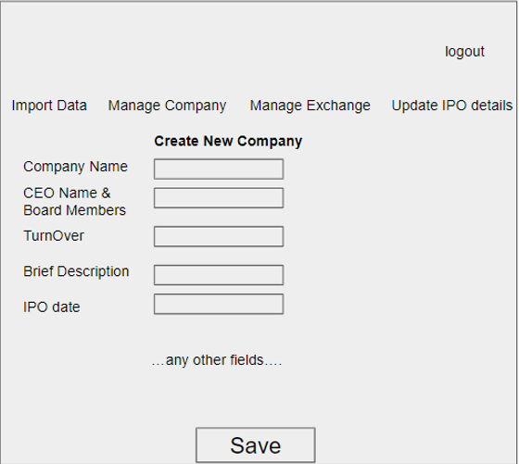
Manage company

Slide 13
User View

Slide 14
Login/Signup for User
Welcome to Stock Market
User name:
Password:
No account yet? Go to Sign Up!

Slide 15
Login/Signup for Admin
Sign Up
User name:
Password:
Confirmed

Slide 16
Login/Signup for Admin
Sign Up
You have created a new account successfully!
User name:
OK!
Password:
Confirmed

Slide 17
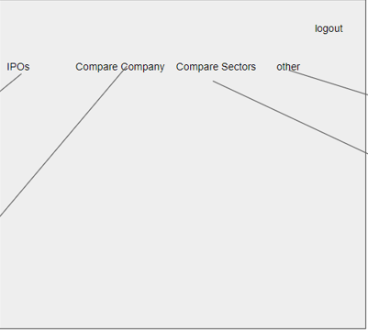
User Landing page
All tabs have the same size. Click each tab, information about it will be displayed and the tab size will be bold.

Slide 18
View IPOs (Optional)
Logout
IPOS Compare Company Compare Sectors Other

Slide 19
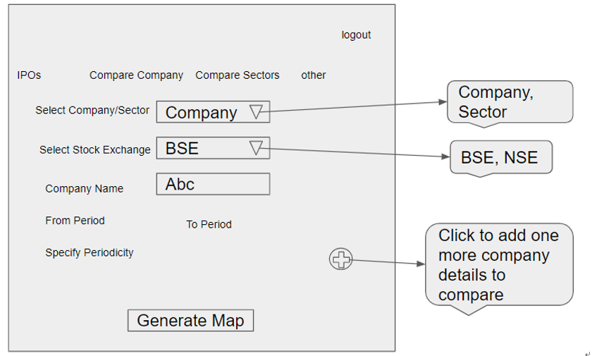
Compare company
Click here to go to the next page

Slide 20
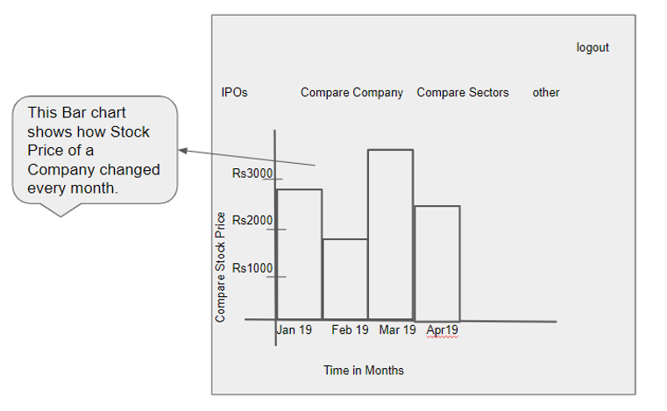
Compare company

